Slide 1
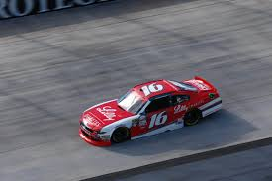
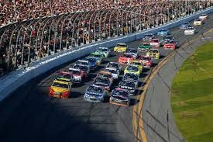
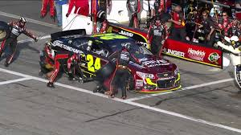
PERFORMANCE TUNING
ISSUES
Bought a race car
Entered many race car in events
Maintained race car
You bought a race car
You entered into many races
During races you need to maintain your race car for optimal performance
4. If during the race you face an issue with the car do you replace tires, replace parts of engine, replace windshield or monitor the car with tools to determine the extent of your issues with the car?

Slide 2
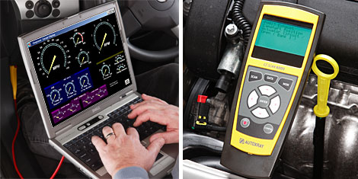
Solution
ISSUES
Bought a race car
Entered many race car in events
Maintained race car
Solution:
You DO NOT the replace tires, replace parts of engine, replace windshield
UNTIL you have monitor the car with tools to determine the extent of your issues with the car!

Slide 3

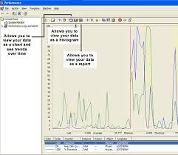
ISSUES
SQL DBA
BOUGHT A NEW AND/OR EXISTING SQL SERVER
OVER COURSE OF TIME, THE SQL SERVER’S WORKLOAD INCREASES
WITH THE INCREASE IN WORKLOAD AND STRESS TO THE SERVER, DO WE REPLACE THE HARDWARE (CPU, MEMORY, DISKS, OR DIAGNOSE THE ISSUES?
SIMILAR TO THE RACE CARE ANALOGY, BEFORE REPLACING HARDWARE OF THE SERVER, WE DIAGNOSE THE SERVER WITH PERFORMANCE TUNING

Slide 4
SQL SERVER PERFORMANCE TUNING PROCESS
THE BUILDING BLOCKS
COMMON PERFORMANCE ISSUES
Slow running queries issues
Fragmentation issue
Wait stats issue
Tempdb improper set up
Poor execution plan choice
SQL Server wrong configurations
Improper index design
Blocking
Building blocks needed for performance tuning
Slow queries
indexes
Fill factor
fragmentation
dmv
Wait stats
hardware
CPU
More information
Sql profiler
memory
Execution plan
Page splits
tempdb
events

Slide 5
REQUIREMENTS
LEARN T-SQL FROM SCRATCH
SQL ADMINISTRATION PART 1
SQL ADMINISTRATION PART 2
SQL ADMINISTRATION PART 3
GO TO UDEMY.COM
IN SEARCH TYPE: RAF ASGHAR
THE COURSE WILL BE DIVIDED INTO TWO SEPARATE COURSES:
SQL PERFORMANCE TUNING PART 1
SQL PERFORMANCE TUNING PART 2 (COMING OUT IN 6 WEEKS)

